Slide 1

Spring - 2 Library Management System

Slide 2
Introduction
This is an Angular based library management system that can be accessed throughout the campus. This system can be used to add books, update books, and view/delete books from the library. This is an integrated system that contains the user component.
Technologies are used : Angular, Html, Css, Bootstrap, Typescript, Javascript, Json server

Slide 3
Implementation
Mapping java Entities for persistence in hibernate
Proper commenting have been done
Login User are also implemented
CRUD Book are also implemented

Slide 4
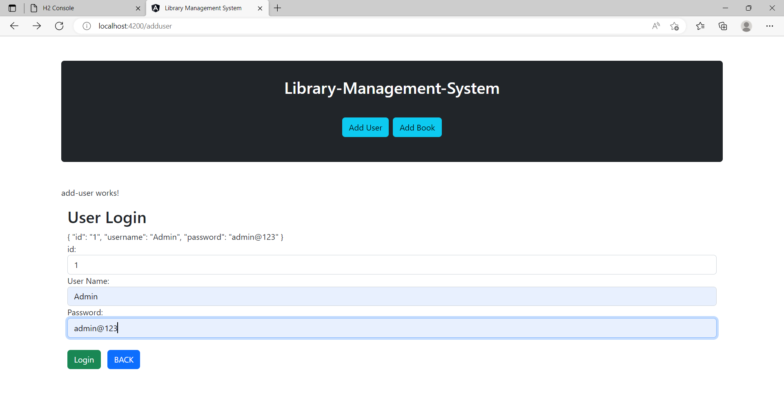
User Login

Slide 5
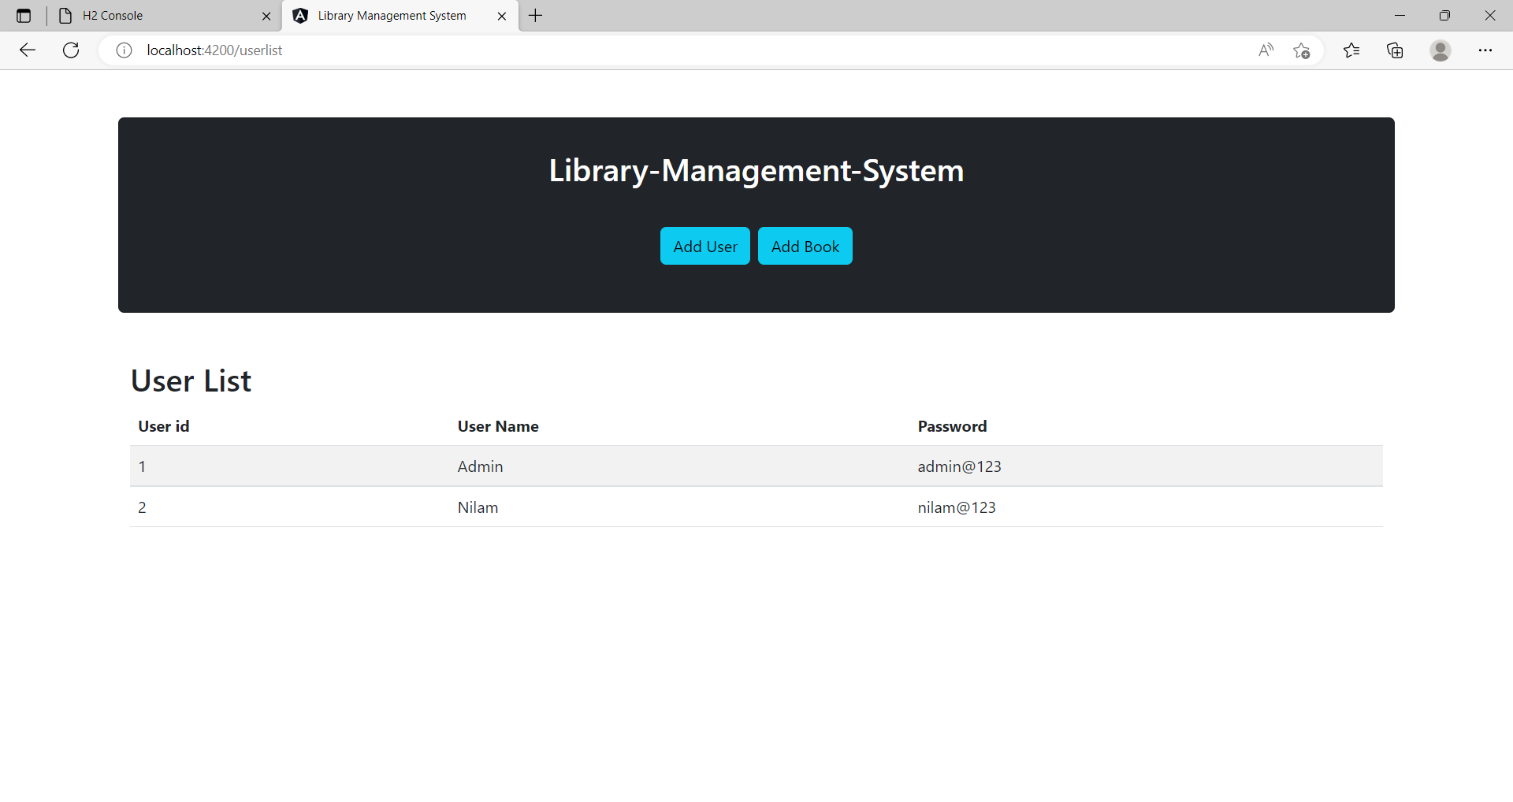
User List

Slide 6
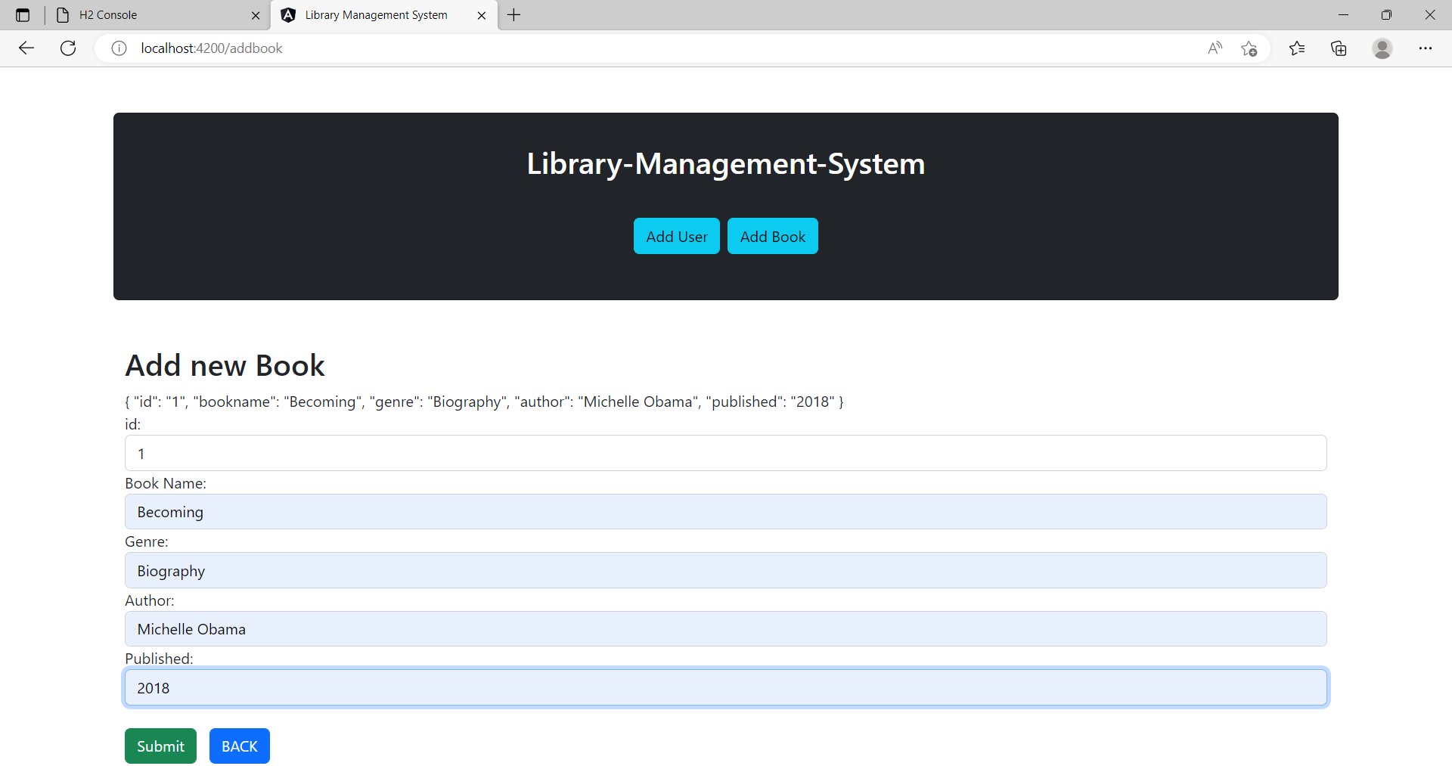
Add new Book

Slide 7
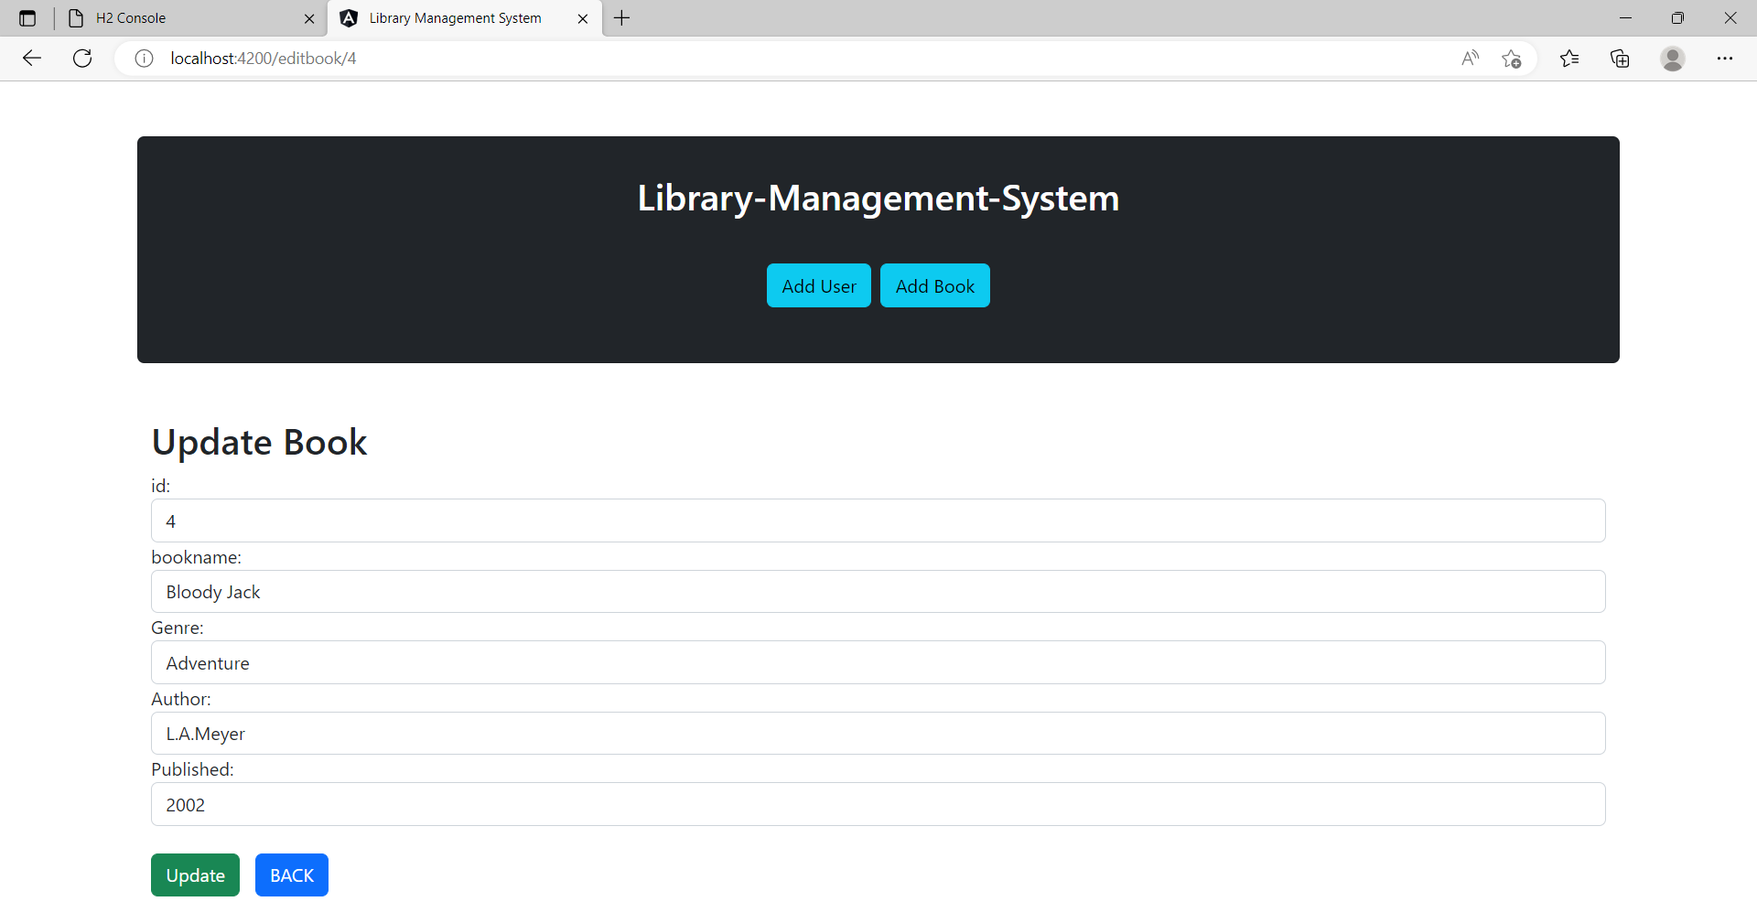
Update Book

Slide 8
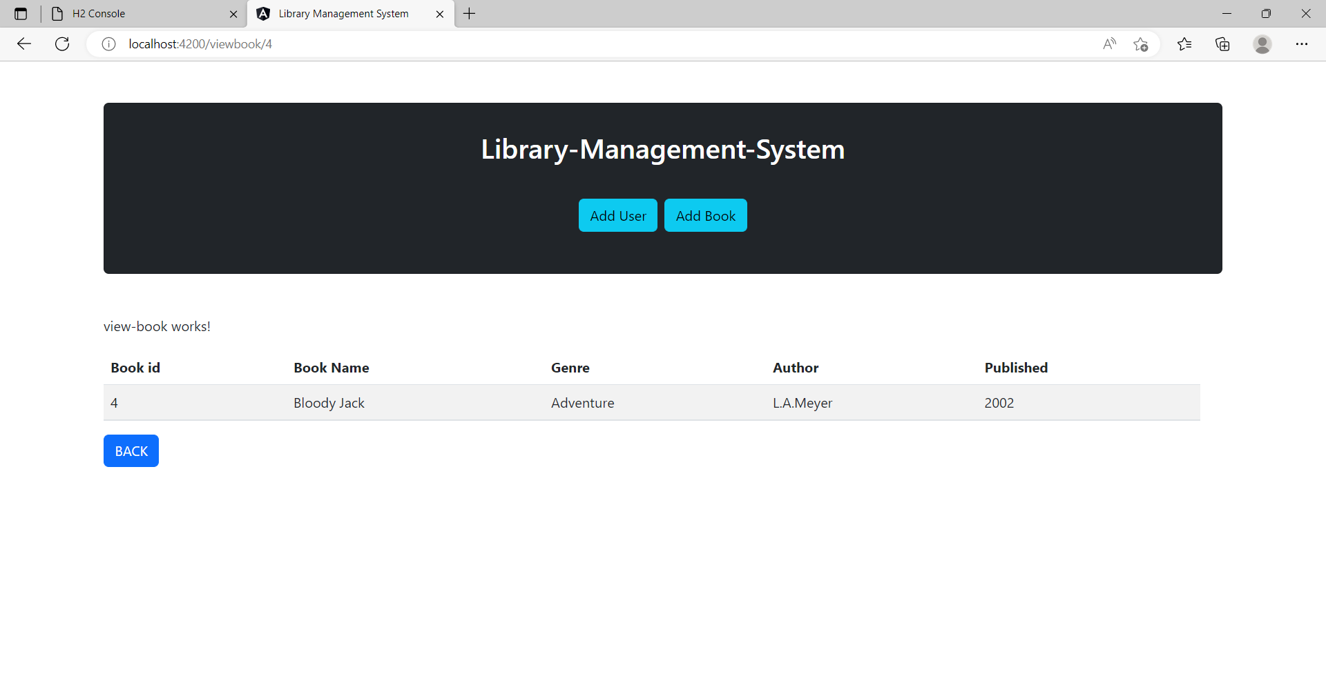
View Book

Slide 9
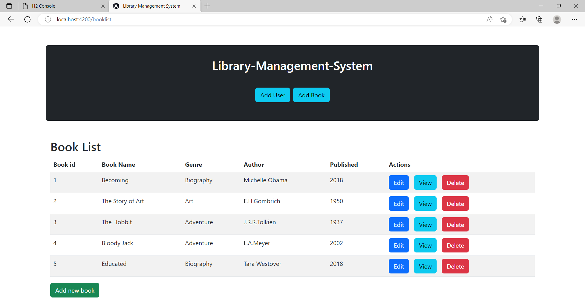
Book List

Slide 10
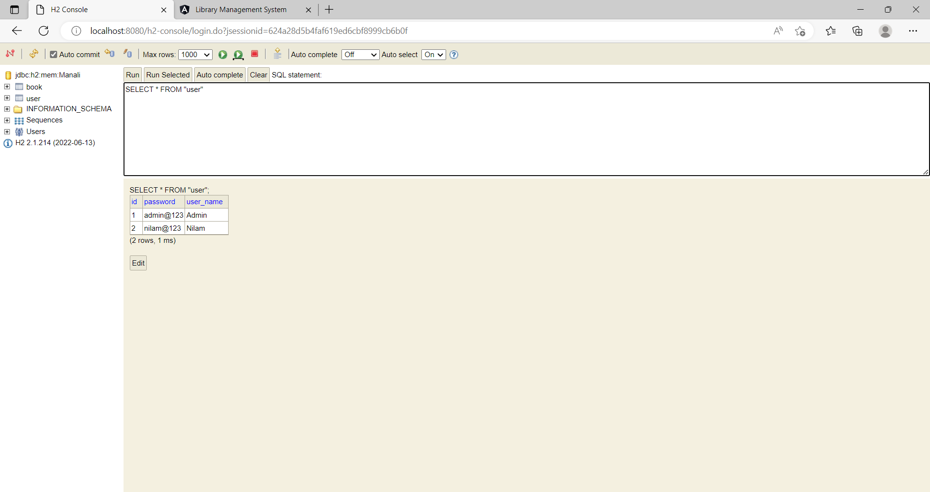
H2 Console

Slide 11
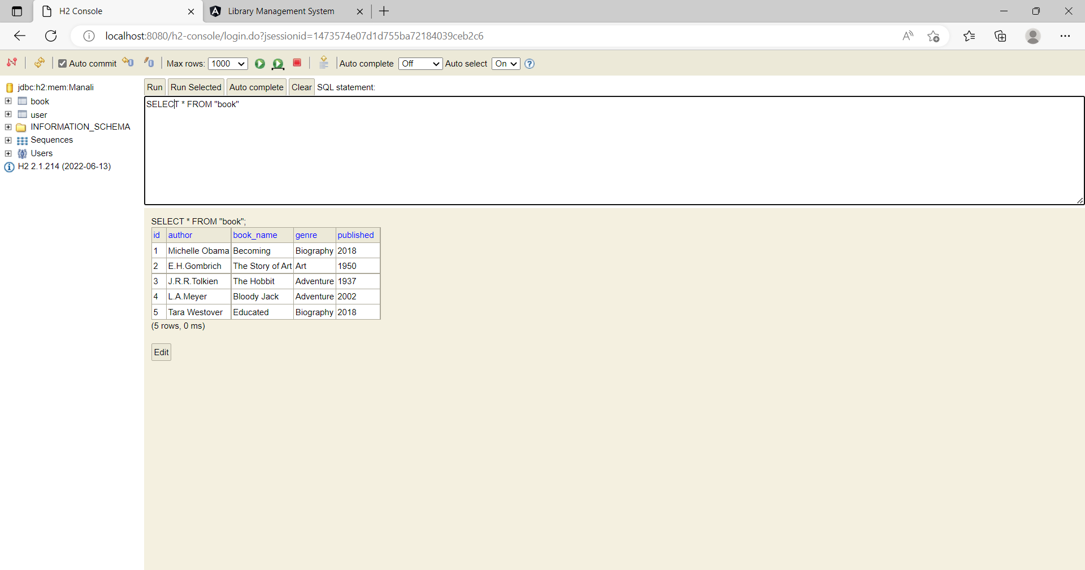
H2 Console

Slide 12
Conclusion
In conclusion, from proper analysis and assessment of the designed system it can be safely concluded that the system is an efficient, usable and reliable Library Management System. It is working properly and adequately meets the minimum expectations that were for it initially. The new system is expected to give benefits to the users in terms of efficiency in the usage of library system.

